Slide 1

The Ps
Erika McCluskey, Jacob Meyer, Favor Fasunwon

Slide 2

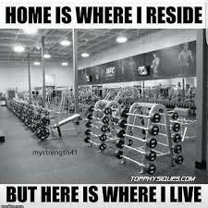
Project Idea Refresher
Workout Website → Progress: Your Path to Success (Brand name)
Tackle the health of individuals, especially in this time period (Corona time).
What this website is intended for includes:
Encouraging individuals to be engaged with exercise
Promote healthy living
Knowing that Exercise is actually fun (some might say this is a bit of a stretch)

Slide 3
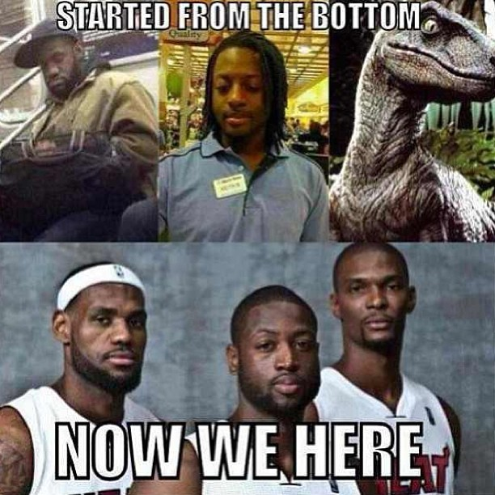
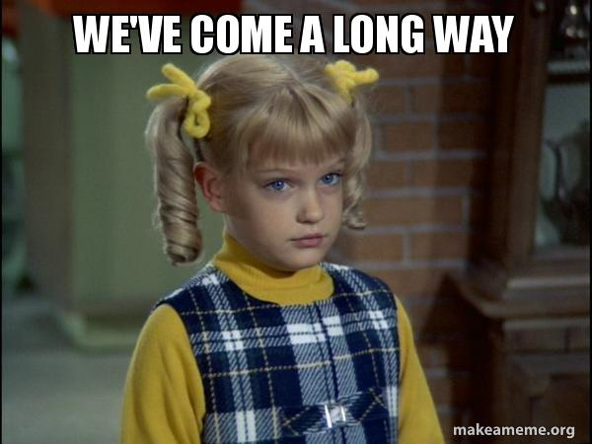
The Beginning To Current
“WHAT” was reduced from a “fitness social” site to more of a single-user tracker/utility app
“WHY” stayed the same
“WHO” is still directed to those who are willing and curious to begin/continue their fitness journey
Notes:
Our initial and current “WHY” of the project still remains to “help people understand and better themselves and the result of their exercise on their physical/mental health hoping to give people a place to find motivation”.
Our “WHAT” stays the same with a few changes coming into play has the code implementation process began. This website is still for all fitness levels, and it is still meant for expanding the knowledge of individuals (especially newbies) who are interested in the fitness world. However, it was decided that the community forum would be kept for a future MVP. The website is now intended for a single-user app.
Our “WHO” hasn’t changed as this website is still intended for individuals who are curious and willing to begin/continue their fitness goals

Slide 4
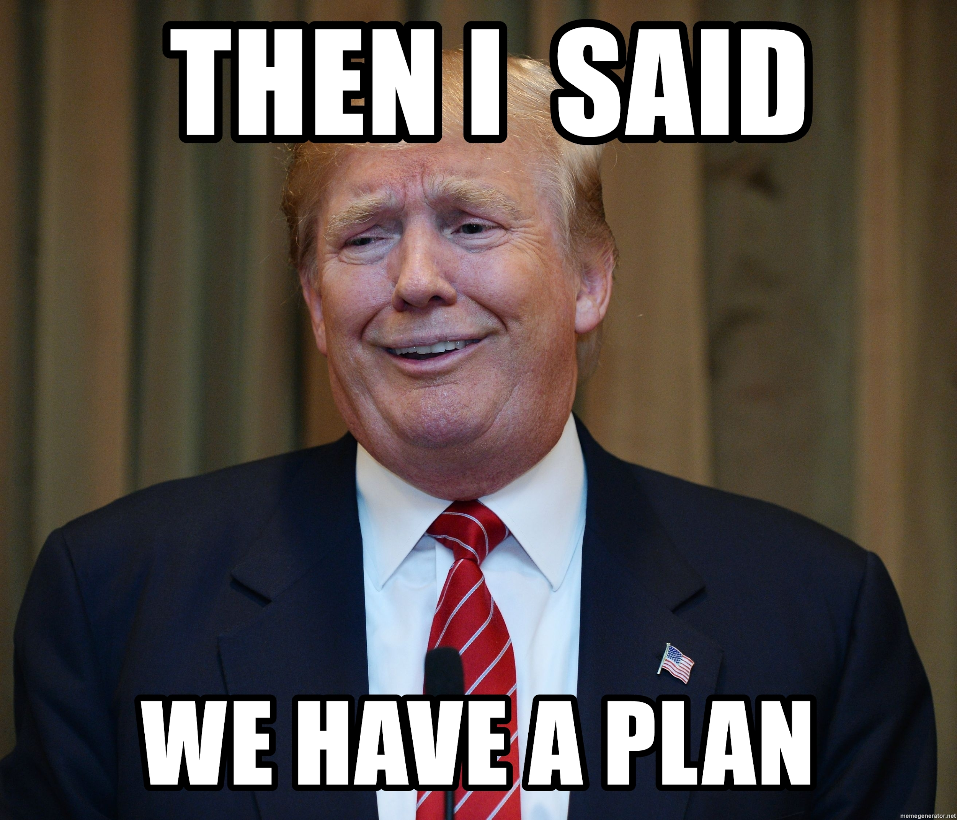
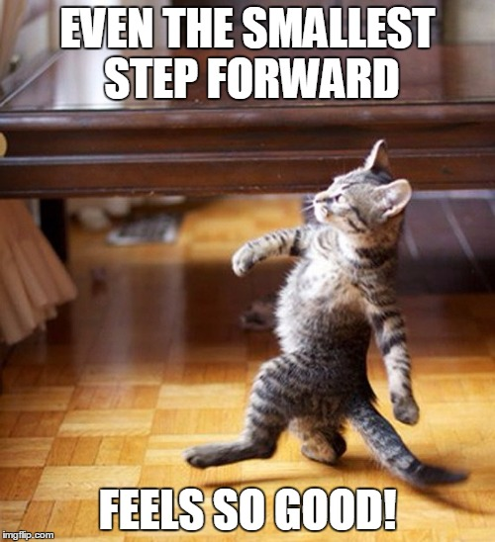
Project Progress/Plan
MVP Changed
Used docs from activity #2 to approach how the project will play out
Update code and docs as required to produce a reasonable MVP
Updating Role and Responsibilities of each member
From rigid to fluid -> everyone ended up working on everything
Notes:
Github Kanban Board is up to date but wasn't used as much as it was supposed to be because we had weekly meetings where we met at least twice a week which cleared up what was to be done for the week. Also we frequently used issues on github to clarify what bugs needed to be fixed as the implementation process carried on.
Use the docs created in Activity #2 (Project Scope, Project Chartier (project objectives)) as an idea template to begin coding website
Begin coding with architectural designs as the main point of direction
As Implementation process began, user stories were considered and changed, therefore, some functionality concepts were updated by either removing or building upon initial code.
MVP changed in a sense that the community forum is now considered as a future MVP (due to the limited time we got). Now our MVP involves our website being for a single user who will be able to view a list of exercises, create workouts with various sets, explore already created workouts, and being able to see their completed workouts
Roles and Responsibilities changed dynamically as the strengths and weakness of each members was made known. Overall, our process moved from rigid to fluid in a sense that everyone ended up working on everything in the end.

Slide 5
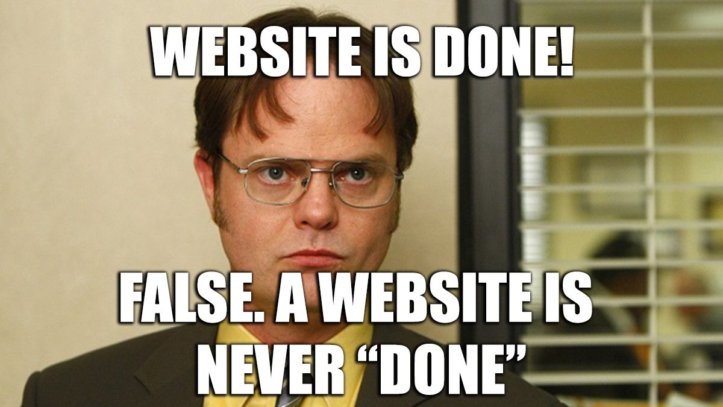
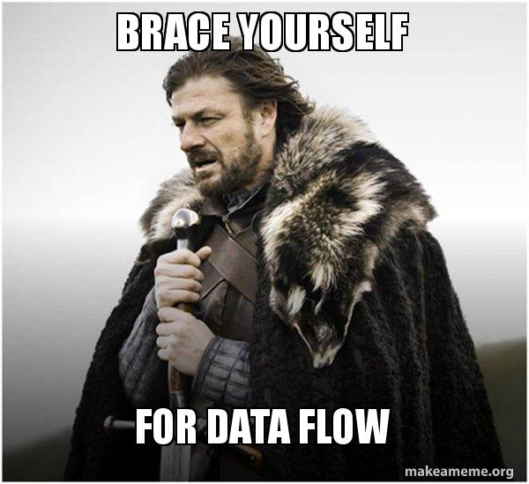
Architectural Design
As the implementation process carried on some architectural designs changed
Lo-fi sketch was updated, as it illustrated a firm concept of how the website should look like
Data flow diagram provided a sensible concept to the movement of data with respect to users stories.
Notes:
After implementing majority of the website we decided to update some architectural designs, as they did not comply with the new design being produced
ERD was used as a template to build the database and observe how the data will be connected to other pages. The data flow diagram was extremely helpful at this point as it made a path to how we will start implementing the back end.
Through the coding process our database implementation changed as we realized that more goes into the data which belongs to a user.
Lo-fi sketch gave a firm illustration on how our website will be laid out, which remained the same for the most part, just with minor changes to where the buttons are placed and removing not highly important decorations
MVC diagram gave a solid ground as to which data is meant to be stored as a model, view or controller.
Updating our MVP played a big part in changing some architectural diagrams as we realized that with the limited time there is only so much that can be implemented. Scratched Community forum.

Slide 6
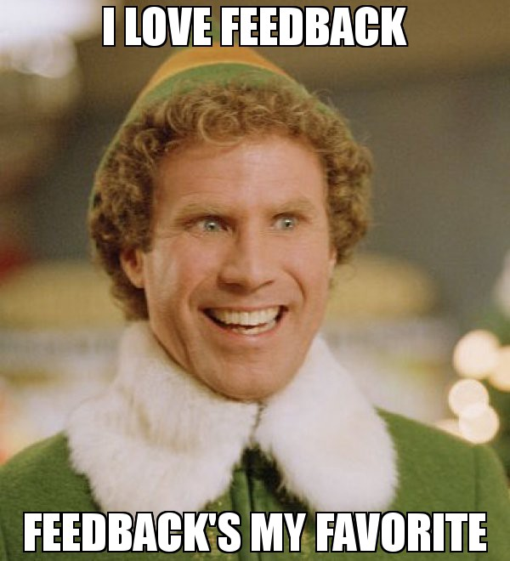
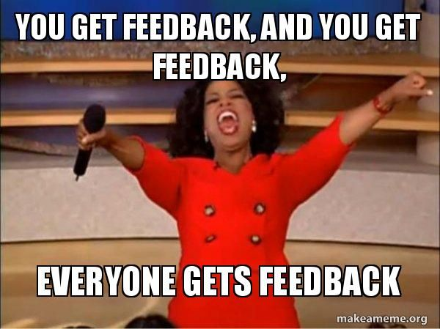
Impact of Feedback (The Galaxy Coasters)
Justify Exercise List
Beware of Scope creep
Update Users stories
Add Login/Signup page
Tim’s comment on rationalizing MVP (community forum could be another MVP (exclude))
Notes:
Based on the feedback from our fellow peers we decided to reinstate a couple concepts such as the amount of exercises to choose from. There are a lot of exercises out there which most definitely will take up space, therefore, we plan on only storing about 20 exercises to start, that way users can at least have a little diversity in the exercises they want to do.
Through the feedback we became more aware of scope creep as we realized we kept introducing new ideas that could make the website more pleasant, however, time does not permit, therefore, they had to be cut out and placed as future MVPs
Users stories were updated and considered frequently when implementing the code. They were changed so the community forum would not be so integrated with it, as the community forum is considered as another mvp. Moreso, the updated user stories now involves the user being able to browse already created workouts by other users.
Since our website incorporates user’s data and was singled to being for one user at a time we decided a login and signup page is necessary, which was then implemented.

Slide 7
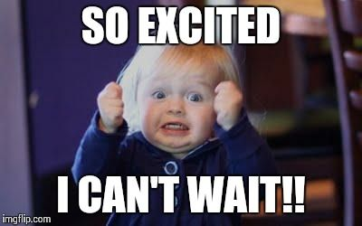
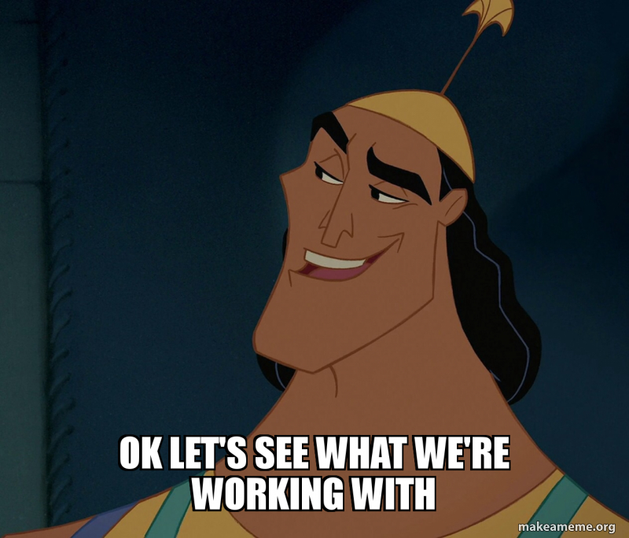
Website Functionality
Some basic functionality include:
Login/Signup
Interactive Navbar to direct to desired page
Create a new workout
View Exercises with their targeted muscle groups
View completed workouts
What makes our design an MVP??
These and more functionality will be illustrated for better understanding within the Demo
Notes:
What makes our design an MVP?
Users can experience our website without getting lost in the transition of pages, as well as it is easy for them to realize how their data is passed through each pages, for example, a table on the home page displays the user’s completed workouts as soon as they mark their workouts as completed.
Everything works for the single user -> workout builder, exercise browser, community workout browser
Community workouts allow exploration of other people’s ideas of what a workout should be
Enabling users to branch out on their own and experiment

Slide 8
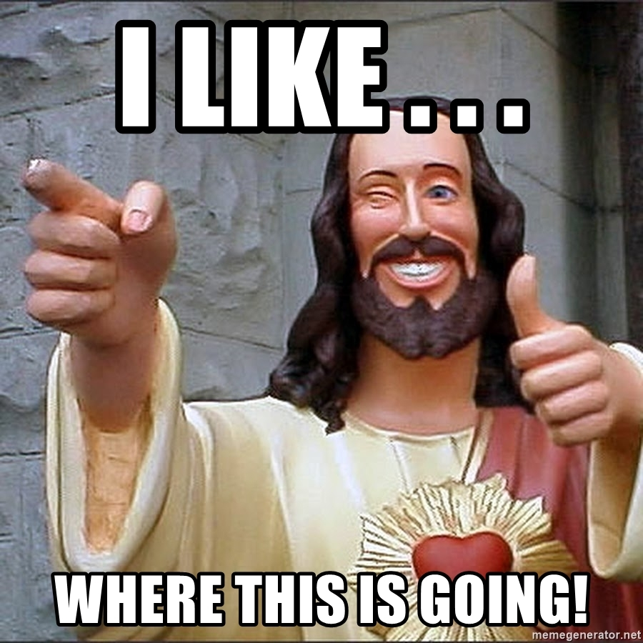
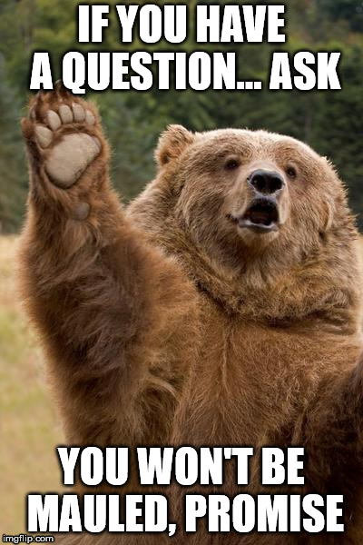
Reflection Time!!!
Change in Roles and Responsibility
Development path
Communication is Key
Knowing members strengths and weaknesses
Notes:
Development path: met during the weekend of Nov 21, there was miscommunication which brought confusion on how the project was going to progress. Fixed it by having another meeting and being honest and open about the issue that happened as well as how to carry on with the projects with the new information provided about the strengths and weaknesses of each member.
These are the questions we would go through as a group but which each input from each member, as i think one person can't speak for the entire group.
How did you feel about this project?
Do you think your team was successful, or?
What did you like about the project?
What did you dislike about the project? Limited guidance
What did your team feel most proud of throughout the entire project experience?
What did you learn about yourself as you collaborated and worked on this project (individually and as a team)
How will you use (or not use) what you have learned/experienced in this project going forward?
What "stuff & things" related to this project would you like more help with?

Slide 9
Q&A

